Slide 1
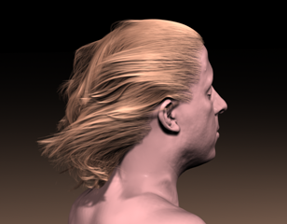
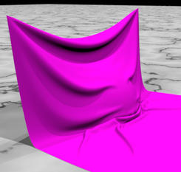
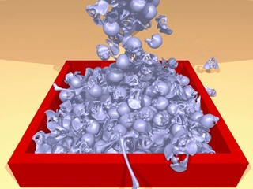
Chapter 5-5 Physically Based Simulation
Hair Modeling & Simulation

Slide 2
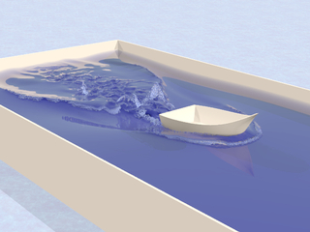
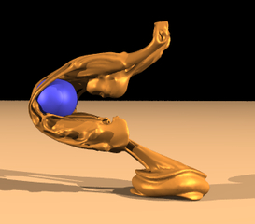
Content
Overview
Cloth Simulation
Particle System
Fluid Simulation
Hair Modeling & Simulation
Summary

Slide 3
5.1 Overview
Hair animation used in movies, games, virtual reality, etc.
Important for representing virtual humans
Problem due to complexity
Human head has over 100,000 strands（缕） of hair
Computation time for simulation and rendering is costly
Notes:
Strand:股

Slide 4
5.1 Overview
Hair Modeling [Magnenat-Thalmann, et al. 2000]
Hair Rendering
Hair color, shadows, lighting, transparency, and anti-aliasing
Hair Shape Modeling (hairstyle)
Geometry of the hair – Shape specification
Density, distribution, and orientation of hair
Hair Simulation
Dynamic Simulation
Collision Detection

Slide 5
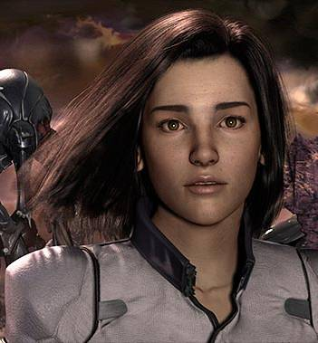
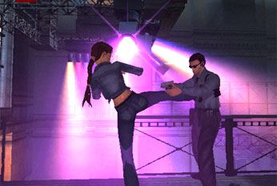
5.1.1 Hair Modeling
Video Game: Lara Croft - Tomb Raider: Angel of Darkness
Movie: Final Fantasy
Factors to consider
Speed vs. Appearance
Short vs. Long
Wavy vs. Straight
Choose hair model based on desired outcome

Slide 6
5.1.2 Hair Simulation
Physics of dynamic simulation
Control motion
Different styles
Geometric representation of hair
Individual strands
Wisps
Strips
Collision detection and response
Hair-Object Interactions
Hair-Hair Interactions
Notes:
Strand：股
Wisp：小束
Strip：带

Slide 7
A Simple Method for Extracting the Natural Beauty of Hair K. Anjyo, Y. Usami, and T. Kurihara ACM SIGGRAPH Computer Graphics, 1992
Hair Animation with Collision Detection T. Kurihara, K. Anjyo, D. Thalmann Models and Techniques in Computer Animation, 1993

Slide 8
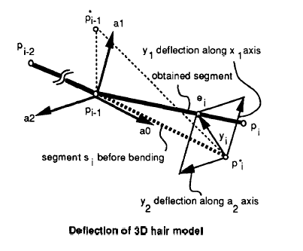
5.2.1 Individual Hair Strands
Hair represented as individual strands
Each strand represented as a series of connected line segments
Notes:
Deflection：偏移

Slide 9
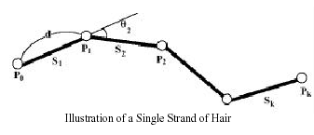
(1) Strand of Hair
Shape represented by angles specified between two segments
Polar coordinates
Zenith θ_{i} （顶点角）
Azimuth Φ_{i}（方位角）
Specify resting position for hair as θ₀ and Φ₀
Notes:
zenith n. 顶点, 极点 azimuth n. 方位角

Slide 10
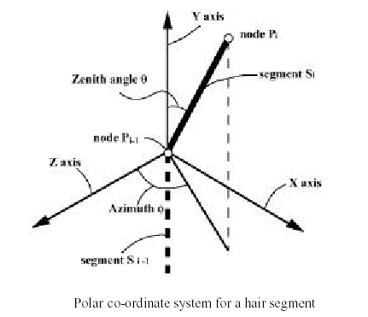
(2) Polar Coordinate System

Slide 11
(2) Polar Coordinate System
Node 0
y
0 ≤ θ ≤ 180°
Section 0
y
N₁
Node 1
θ₁
z
Section 1
x
Φ₁
N₂
z
0 ≤ Ф ≤ 360°
d
x
Nodes, or control points, control the shape of the skeleton
z

Slide 12
5.2.2 Physics of Motion
Apply forces to control points
Use torque for resulting motion of control points
M_{θspring,} M_{Φspring} between two segments
M_{θexternal,} M_{Φexternal} from external forces
Gravity, Wind
M_{θ} = M_{θspring} + M_{θexternal}
M_{Φ} = M_{Φspring} + M_{Φexternal}

Slide 13
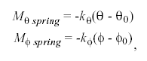
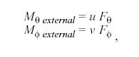
5.2.2 Physics of Motion
where k_{θ} and k_{Φ} are spring constants and θ₀ and Φ₀ are initial angles
u is (1/2)d,
d is the length of a segment of hair
v is the half length of the segment that is the projection of s_{i} onto the Φ plane.

Slide 14
5.2.3 Collision
Hair-Hair collision ignored
Collision Detection with Head and Body
Divide human body into several parts and create a cylindrical representation
Collision detection reduced to checking for control points inside or outside of cylinders

Slide 15
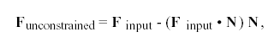
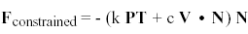
5.2.3 Collision
Collision Reaction
Use lookup table and bi-linear interpolation to find normal vectors for collision response direction
Reaction constraint method by Platt and Barr 1988 is used:
N = normal vector at point T
V = velocity of point P
c = damping coefficient
k = strength of the constraint
F_{input} = applied force to node point P

Slide 16
5.2.4 Limitations
Simulating each strand very costly
Collision detection is just rough estimation
Can fail to detect collisions
Some objects cannot be represented well as cylinder, particularly top of head
Cannot be applied to hair-hair collisions

Slide 17
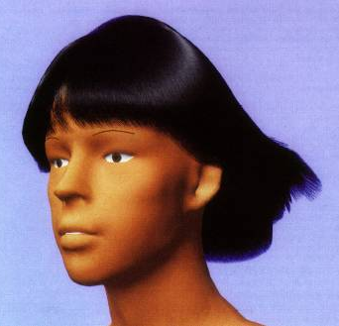
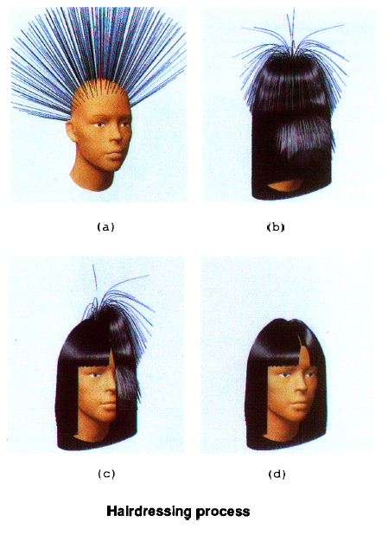
5.2.5 Setup and Styling Hair

Slide 18
A Layered Wisp Model for Simulating Interactions inside Long Hair
E. Plante, M. Cani, P. Poulin
Proc. of Eurographics Workshop on Animation and Simulation, 2001

Slide 19
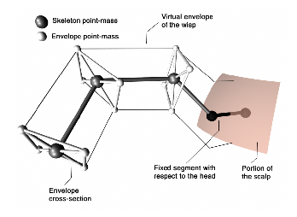
5.3.1 Layered Wisp(束) Model
Skeleton Curve
Defines global motion and deformations
Deformable Envelope
Coats skeleton, defines deformations of wisp sections
Hair Strands
Individual strands of hair for rendering

Slide 20
(1) Wisp Skeleton
Defines global movements and deformations of wisp
Chain of point-masses linked by linear damping
Create motion by applying forces to point-masses
Similar to strand of previous works

Slide 21
(2) Wisp Envelope
Surrounds the skeleton and defines deformations of the wisp sections
Responsible for motion that occurs when the group of hair, or wisp, is stretched or compressed

Slide 22
(2) Wisp Envelope
Broken up into cross-sections that are associated with each point-mass of skeleton
Shape of cross-section dependent on number of envelope point-masses used
Envelope point-masses linked to skeleton point-masses through damped springs

Slide 23
(3) Hair Strands
Individual strands of hair are placed within the wisp for rendering
Strands placed randomly within cross-section of wisp, skeleton is origin
Catmull-Rom piecewise cubic curves are used to define strands

Slide 24
5.3.2 Hair-Hair Collisions
Interactions between wisps
Create bounding boxes around wisp segments
Test bounding boxes against each other to detect collision
Checks for penetration of envelope or skeleton point mass into another bounding volume
Wisp envelopes can be compressed depending on orientation of colliding wisps
If same orientation, allow collision

Slide 25
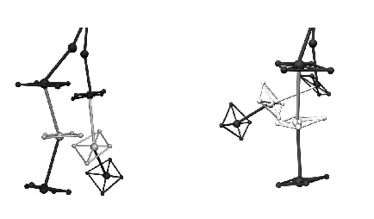
5.3.2 Hair-Hair Collisions
Volume defined by two cross-sections
Check orientations of wisps
Determine if collision is allowed
If not, determine if a point-mass is inside the volume of another wisp section

Slide 26
5.3.3 Hair-Object Collisions
Interactions between wisp and person
Sliding Contact
Check point-mass close to body (within threshold)
Eliminate velocity of point-mass
Penetration Reaction
If point-mass (either envelope or skeleton) collides with the body, move point-mass outside of body then use “sliding contact” method

Slide 27
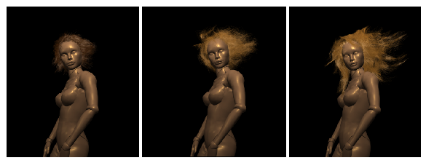
5.3.5 Results

Slide 28
5.3.5 Results
Timings
~0.023 to 0.025 fps
Short Hair
199 wisps
4 segments per wisp
Medium Hair
73 wisps
9.9 segments per wisp
Long Hair
56 wisps
7.7 segments per wisp
92 to 95% of total computation time spent on collision detection
64 to 70% wisp self-interactions
30 to 36% wisp-object interactions

Slide 29
A Simple Physics Model to Animate Human Hair Modeled in 2D Strips in Real Time
C. K. Koh, Z. Huang
Proc. of Eurographics Workshop on Animation and Simulation, 2001

Slide 30
5.4.1 Physics of Motion
Group hairs into 2D strips represented as NURBS surfaces
Dynamic equations are defined and solved for the control points of the surface
Physics model used is same as previous examples

Slide 31
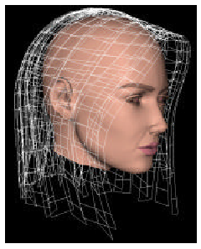
5.4.2 Setup of Hair
Hair strands are represented in layers of strips overlaying each other to cover the head
Surfaces are texture mapped with hair images
Alpha map is used to define transparency

Slide 32
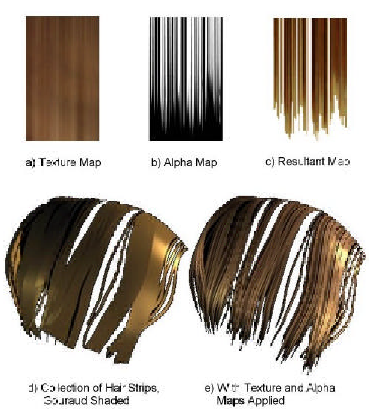
5.4.2 Setup of Hair

Slide 33
5.4.3 Collision Detection & Avoidance
Hair strips and external objects (head)
Ellipsoids used to represent head
Similar to previous techniques
Hair strips and other hair strips
Use avoidance
Springs between strips
Spring force used for either repulsion or attraction
Where k_{s} is the spring constant and x_{s} is the displacement from initial rest length, i is control point index, s is spring index
F_{i} = Σ(-k_{s} * x_{s})

Slide 34
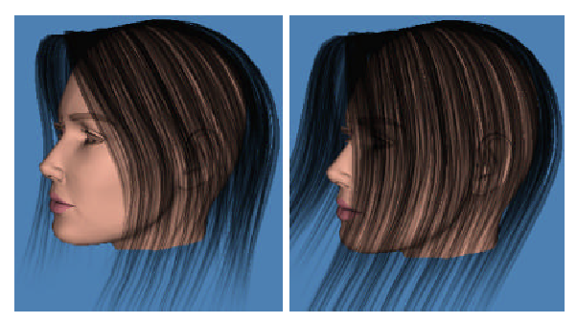
5.4.4 Results

Slide 35
Modeling Hair using Level-of-Detail Representations K. Ward, M. Lin, J. Lee, S. Fisher, and D. Macri Proceedings of Computer Animation and Social Agents, 2003
Adaptive Grouping and Subdivision for Simulating Hair Dynamics Kelly Ward and Ming C. Lin Proceedings of Pacific Graphics, 2003

Slide 36
5.5.1 Overview
Propose method to model hair using three discrete representations
Create hair hierarchy from these representations creating continuous LODs
Dynamically switch between different representations based on:
Visibility
Viewing Distance
Motion of Hair

Slide 37
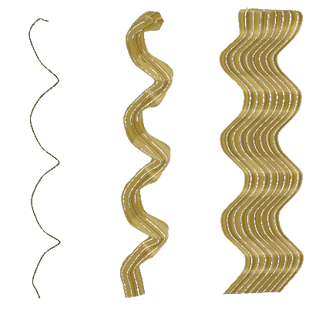
5.5.1 Overview
Three Representations to model hair
Individual Strands（缕）
Modeled with subdivision curves
Clusters （簇）
Generalized cylinders created with subdivision surfaces
Strips（条）
Modeled with subdivision surfaces

Slide 38
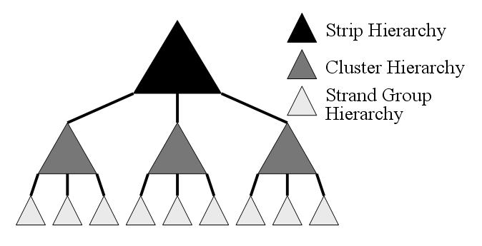
5.5.1 Overview
Hair Hierarchy
Create hierarchies of each representation
Generates continuous LODs

Slide 39
5.5.2 Base Skeleton
All hair representations follow the same base skeleton model as basis of motion
Maintains global physical behavior of hair
Modeled as open chain of line segments
Spring forces used to control angles
P₀
s₁
y
P₁
P_{i}
θ_{i}
s₂
x
P₂
P_{i+1}
P₃
z
ф_{i}
P₄

Slide 40
5.5.3 Subdivision Framework
Subdivision curves and surfaces used for geometric representations
Ability to model each LOD shape and different hairstyles
Adaptive dynamic tessellation
Continuous LODs for rendering
Notes:
Tessellation n. 镶嵌成小方格,棋盘形布置,镶嵌式铺装

Slide 41
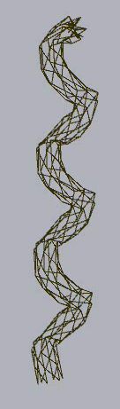
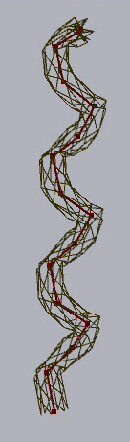
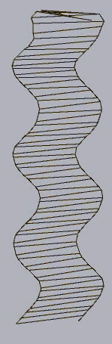
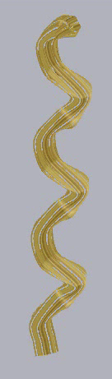
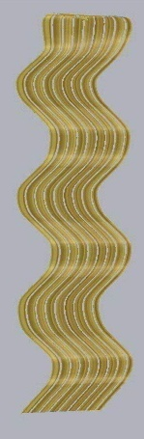
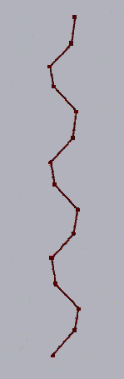
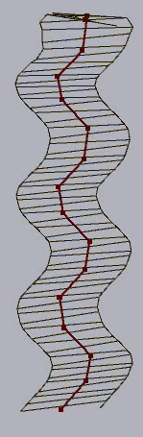
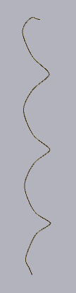
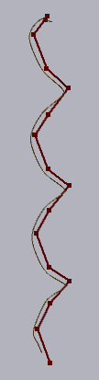
5.5.4 Geometric Representation

Slide 42
5.5.5 Hair Dynamics
Base skeleton controls hair dynamics
Implicit Integration
Obtain more stable integration in comparison to explicit techniques
Use Polar Coordinates
Notes:
For our hair dynamics model we follow methods proposed by earlier hair simulation works.
We also use implicit integration over explicit integration in order to attain more stable simulations. Using implicit integration we were able to take larger time steps with more stability. Since the angles between the skeleton control points are specified in polar coordinates, the dynamics equations also use polar coordinates. Our implicit integration derivation is given in the appendix of our paper.

Slide 43
5.5.6 Collision Detection & Response
Typically most time-consuming process in simulation
Exploit level-of-detail framework
Simplify collision detection and response algorithm
Still maintains accurate and consistent simulation state
Two types of collisions
Object-Hair Interactions
Hair-Hair Interactions

Slide 44
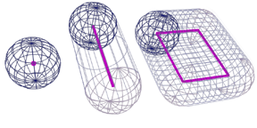
(1) Collision Detection
Swept Sphere Volumes (SSVs) [Larsen et al. 1999]
Bounding volumes to encapsulate hair
Shape closely matches each LOD geometry
Simple collision detection algorithm:
Calculate distance between core shapes (line or rectangle)
Subtract appropriate offset (radius of each SSV)
Notes:
Our collision detection framework uses the family of swept sphere volumes or SSVs as the bounding volume used to encapsulate each hair type. SSVs are BVs created by taking a core primitive – such as a point, line or rectangle – and sweeping a sphere of a given radius around the primitive to create the final bounding volume. Some SSVs are shown in the diagram – here we have a point swept sphere, line swept sphere, and rectangular swept sphere.
We chose to use SSVs because of their close geometric match to our hair representations. We use LSS to encapsulate the strands and clusters and RSSs for the strips.
Furthermore, SSVs provide a simple and quick algorithm for detecting collisions. We calculate the distance between the core shapes and then subtract the appropriate offset – which is the radius of each SSV.

Slide 45
(2) Hair-Hair Interactions
Use spatial decomposition – Only test sections of hair near each other
Compute overlap between two SSVs
Use orientations of SSVs to determine response
Near Parallel: Average velocites
Else: Push apart SSVs based on overlap and average velocites
Notes:
For our hair-hair interactions, our algorithm first uses spatial decomposition to only test sections of hair that are near each other.
We compute the amount of overlap between two SSVs. If they overlap, we calculate a collision response depending on the orientations of the given SSVs. If the SSVs are nearly parallel with each other then we simply average the velocities of the respecting hair sections. If they are closer to perpendicular to each other, then we push apart the sections of hair based on their overlap and average their velocities.
More detail on this process is provided in the paper.

Slide 46
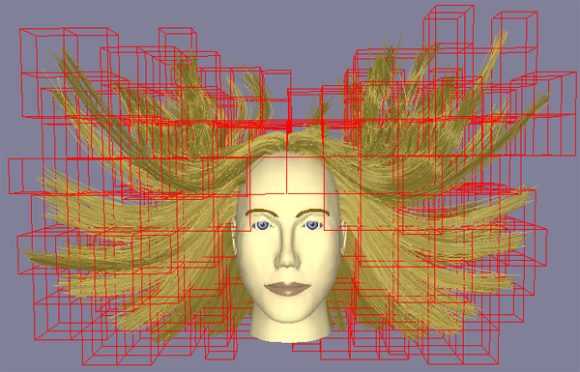
(2) Hair-Hair Interactions
Notes:
For our hair-hair interactions, our algorithm first uses spatial decomposition to only test sections of hair that are near each other.
We compute the amount of overlap between two SSVs. If they overlap, we calculate a collision response depending on the orientations of the given SSVs. If the SSVs are nearly parallel with each other then we simply average the velocities of the respecting hair sections. If they are closer to perpendicular to each other, then we push apart the sections of hair based on their overlap and average their velocities.
More detail on this process is provided in the paper.

Slide 47
(3) Hair-Object Interactions
Occurs when hair interacts with body/head
Impenetrable object
Encapsulate object with bounding volume hierarchy (BVH) of SSVs
Recursively test hair SSV against BVH
When collision occurs
Move section of hair outside of object
Set velocity of hair in direction of object to zero
Notes:
Hair-Object interactions occur when hair collides with some sort of impenetrable object such as the head or body. We must make sure the hair does not overlap with these objects regardless of their orientation.
In order to accelerate the collision detection process we encapsulate the given object with a BVH of SSVs and recursively test a section of hair against the hierarchy.
If there is a collision, then the section of hair is moved outside of the head or object and the velocity of the hair in the direction of the head is set to zero.

Slide 48
5.5.7 Runtime Selection
Put more computational resources on hairs that are most important to viewer
Visibility
Viewing Distance
Hair Motion
Entire head of hair is using combination of different hair resolutions at any given point
Add more detail or simplify at any time on any position on head

Slide 49
(1) Visibility
Hair cannot be seen if:
Outside field of view of camera
Occluded by object in scene
Perform simple occlusion tests on hair to determine visibility
If hair is not visible
Simulate hair as strips
Do not render hair

Slide 50
(2) Viewing Distance
Hair that is far from viewer cannot be seen in great detail
Determine amount of screen space hair covers
As distance from viewer grows, number of pixels covered by hair decreases
Calculate screen space covered by skeleton
Test value against maximum allowable size for each LOD

Slide 51
(3) Hair Motion
Relatively still hair does not have much detail to view
Wind or large avatar motion causes more viewable detail
Measure the largest force acting on each section of hair
Compare force to thresholds for strands vs. clusters vs. strips

Slide 52
5.5.8 Hair Hierarchy
Hierarchy of Hierarchies
Contains both discrete and continuous LODs

Slide 53
(1) Benefits of Hair Hierarchy
Gives more localized control over simulation
Generates continuous LODs throughout simulation
Transitions between LODs are less noticeable
Natural progression in detail
Hierarchy can be traversed on the fly
Results in higher visual quality simulation

Slide 54
(2) Construction of Hair Hierarchy
Constructed offline as a pre-process
Continual subdivision of strand groups, clusters, and strips
Build hierarchies in top-down manner
Gain more detail down the hierarchy

Slide 55
(3) Hierarchy Construction

Slide 56
(4) Subdivision of Hair
Cross-section of strand grouping
Divide into four equal parts
Line Swept Sphere(LSS) tightly fits for collision detection
Placement of strands remains consistent
Notes:
linesweptsphere,LSS紧凑性好，更新代价低

Slide 57
(4) Subdivision of Hair
Cross-section of strand grouping
Divide into four equal parts
LSS tightly fits for collision detection
Placement of strands remains consistent
Fit circular cross-section to four children

Slide 58
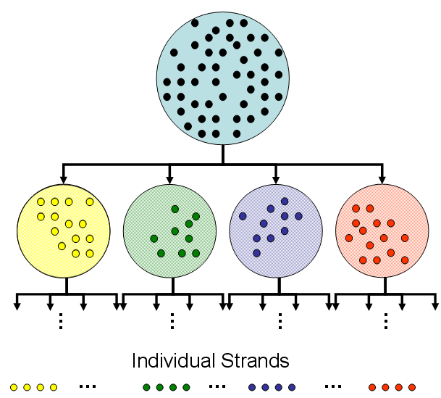
(4) Subdivision of Hair

Slide 59
(5) Transitions Between LODs
Hair hierarchy allows localized LOD control of hair
Traverse hierarchy to select appropriate LOD throughout simulation
Crucial to perform transitions smoothly to avoid visual artifacts
During traversal either:
Adding Detail: One skeleton → Multiple skeletons
Simplifying: Multiple skeletons → One skeleton

Slide 60
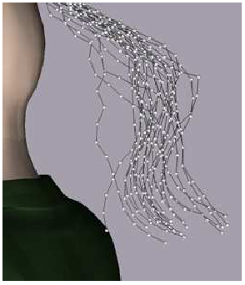
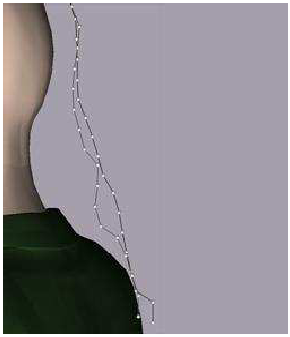
(6) Adaptive Splitting

Slide 61
(6) Adaptive Splitting
Move down one level in hierarchy
Add detail to simulation
Simplified through use of base skeleton
Child skeletons inherit dynamic state of parent skeleton
Velocity is copied from parent
Position is offset from parent

Slide 62
(7) Adaptive Grouping

Slide 63
(7) Adaptive Grouping
Multiple skeletons → One skeleton
Average velocity and position of children and assign to parent
Constraints placed on merging:
All children must be ready to transition to parent
Positional constraint on children to avoid sudden jump

Slide 64
5.5.9 Performance
 | Fine Strands | LODs | Coarse Strands
Dynamic Simulation | 0.1076 | 0.0416 | 0.0383
Collision Detection | 7.6423 | 0.4118 | 0.3383
Total | 7.7499 | 0.4534 | 0.3766
Measured in Seconds/Frame
9,350 individual strands (rendered)
3,570 skeletons at finest level
Skeletons contain an average of 6 control points
Wind Blowing through hair
Camera remains stationary

Slide 65
5.5.9 Performance
 | LODs | Strands | Clusters | Strips
Dynamic Simulation | 0.02614 | 0.1076 | 0.01537 | 0.00324
Collision Detection | 0.23949 | 7.6432 | 0.17178 | 0.02014
Total | 0.26563 | 7.7508 | 0.18715 | 0.02338
Measured in Seconds/Frame
9,350 individual strands (rendered)
3,570 skeletons at finest level
110 Strips at coarsest strip level
330 Clusters at coarsest cluster level
Wind Blowing through hair
Camera moves away from figure

Slide 66
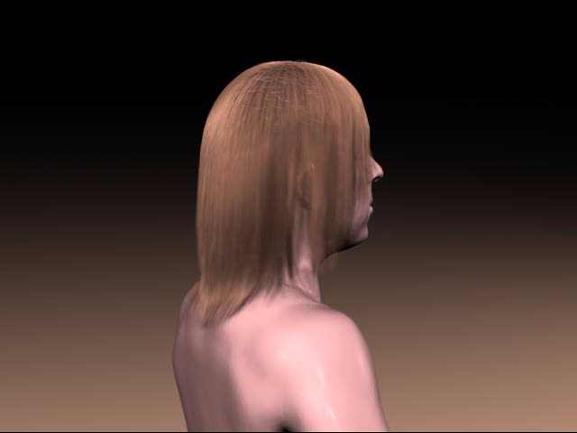
Demo

Slide 67
References
K. Anjyo, Y. Usami, and T. Kurihara. A simple method for extracting the natural beauty of hair. Computer Graphics, 26(2):111-120, 1992.
T. Kurihara, K. Anjyo, and D. Thalmann. Hair animation with collision detection. In Models and Techniques in Computer Animation, pages 128-38. Springer-Verlag, 1993.
C. K. Koh and Z. Huang. A simple physics model to animate human hair modeled in 2d strips in real time. Proc. of Eurographics Workshop on Animation and Simulation, 2001.
E. Plante, M. Cani, and P. Poulin. A layered wisp model for simulating interactions inside long hair. Proc. of Eurographics Workshop on Animation and Simulation, 2001.
K. Ward, M. C. Lin, J. Lee, S. Fisher, and D. Macri. Modeling hair using level of detail representations. Proc. of Computer Animation and Social Agents, 2003.
K. Ward and M. C. Lin. Adaptive grouping and subdivision for simulating hair dynamics. Proc. of Pacific Graphics, 2003.

